Slide 1
Office Camp
September 2014

Slide 2
Course Agenda
Office Camp
Module 1: Introduction to the Day
Module 2: Setting up the Environments
Module 3: Hooking into Apps for SharePoint
Module 4: Hooking into Office 365 and SharePoint APIs with SPAs
Module 5: Hooking into Apps for Office

Slide 3
Hooking into Apps for Office
Speaker
Title

Slide 4

Agenda
Intro to the Office 365 APIs
OAuth and the Office 365 APIs
Notes:
What new APIs are available, in preview, in the Office 365 Platform
How to use these API’s in your platform of choice
Some sample business scenarios for leveraging these API’s
Level: Intermediate
Audience: Developer Essentials

Slide 5
Intro to the Office 365 APIs

Slide 6
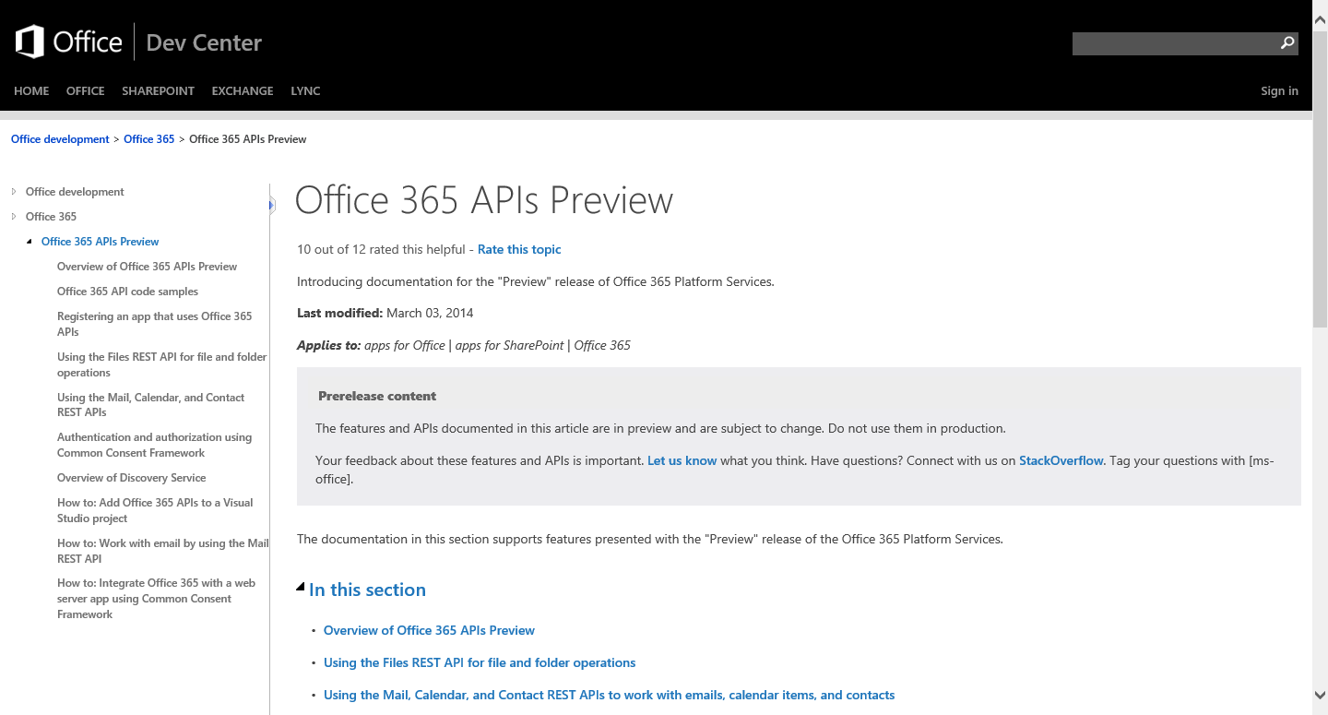
http://aka.ms/Office365DevAPIs
Notes:
The Office Dev Center is your primary resource

Slide 7
Office 365 APIs Roadmap
Active Directory
Exchange & Outlook.com
SharePoint
OneDrive
Sites
OneDrive
Users
Mail
Calendar
Client API
OneDrive for Business
Sites, Lists and Libs
Taxonomy
Groups
Contacts
Workflow
BCS
Search
…
Notes:
Office 365 APIs allow access to all of the key resources in Office 365

Slide 8
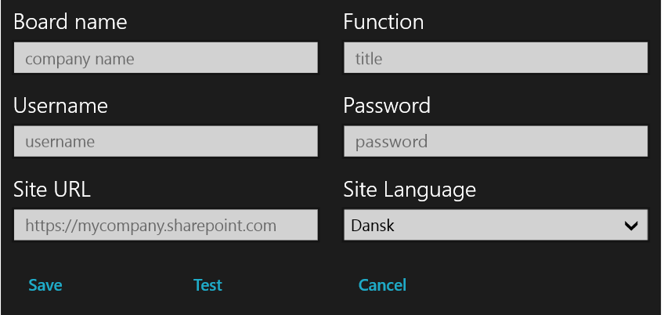
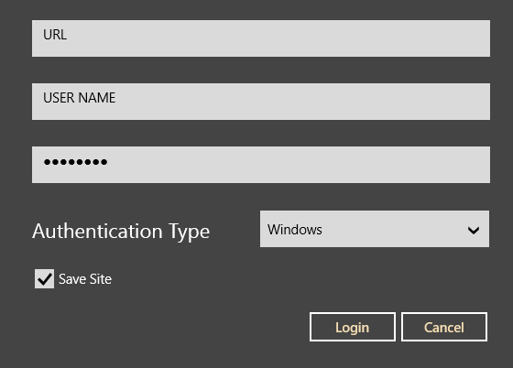
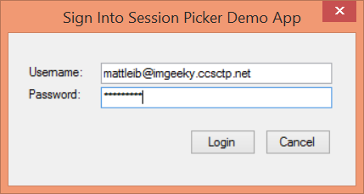
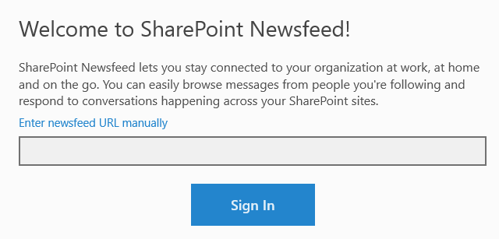
Office 365 device apps
Notes:
The point here is that the Office365 APIs enable several different kinds of applications to access O365 data
Azure applications
Windows 8 apps
Office apps
Phone apps

Slide 9
Visual Studio project support
.NET Windows Store Apps
Windows Forms Application
WPF Application
ASP.NET MVC Web Application
ASP.NET Web Forms Application
Xamarin Android and iOS Applications
Multi-device Hybrid Apps (Cordova)
Notes:
Project types supported

Slide 10
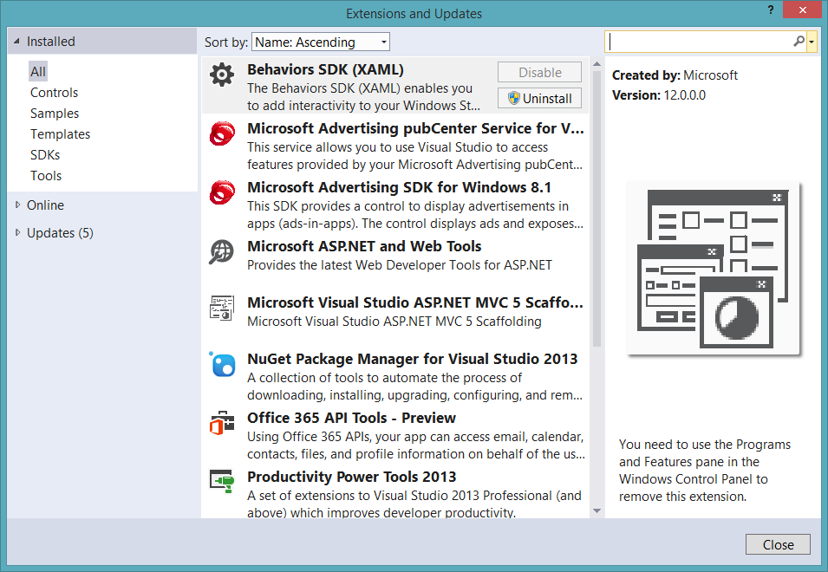
Get the tools
Notes:
The tooling is available as an extension

Slide 11
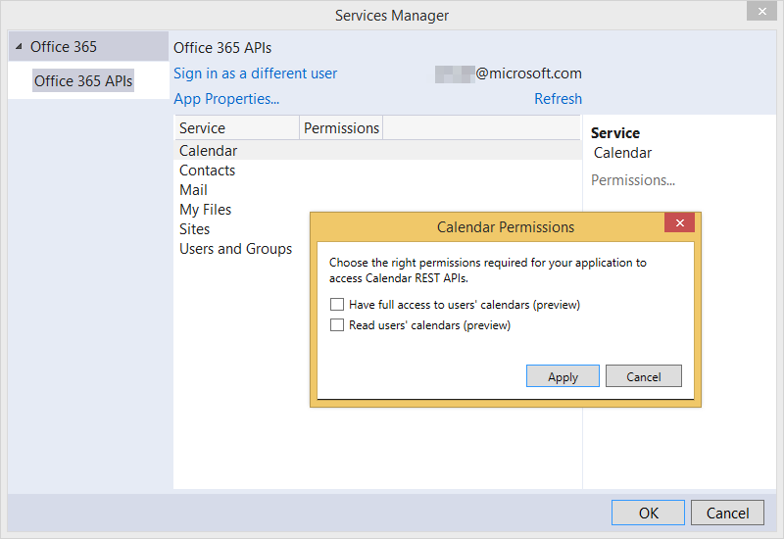
Notes:
App permissions are granted in Visual Studio

Slide 12
Office 365 discovery services
Automatically determine URL of O365 services
Supports device app and website flows
Secured using Azure AD authentication
Serves information stored about services in AAD
Notes:
The heart of the O365 APIs is the discovery service
Discovery services allow you to locate the e resource you want to utilize

Slide 13
Office 365 Clients
AadGraphClient – Azure Active Directory
ExchangeClient – Calendar, Contacts, Mail
SharePointClient - Files

Slide 14
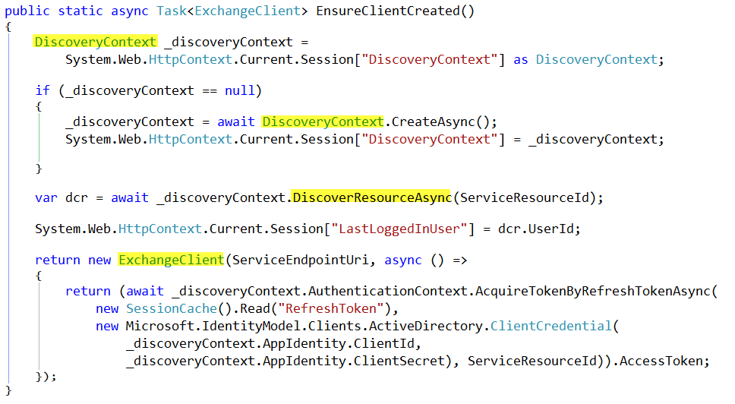

Slide 15
demo
Task Pane App in Word

Slide 16
OAuth and the Office 365 APIs

Slide 17
OAuth 2.0
No capturing user credentials
Fine-grained access scopes
Supports MFA and federated user sign-in
Long-term access through refresh tokens

Slide 18
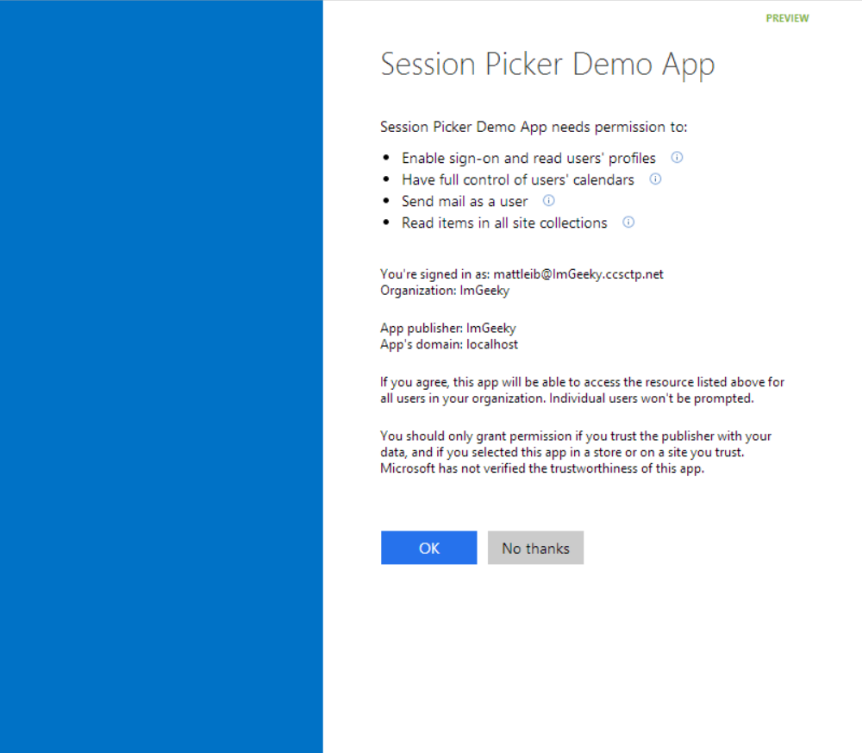
Common consent
Notes:
Common consent framework means that users can grant apps permissions on the fly
Or Administrator can grant app permissions in Azure Active Directory

Slide 19
O365 APIS Flow Scenario
User has Organizational Account
Application deployed as an Azure Web Site
Application does not require explicit permission grant
Notes:
This is a scenario for tracing the OAuth flow in the next few slides

Slide 20




OAuth 2.0 Flow O365 APIs
Azure Web Site
(Client)
End User
(Resource Owner)
Azure ACS
(Authorization Server)
SharePoint Online
(Resource Server)

Slide 21
OAuth 2.0 Flow O365 APIs
Azure Web Site
(Client)
User accesses
Web application
End User
(Resource Owner)
Azure ACS
(Authorization Server)
SharePoint Online
(Resource Server)

Slide 22
OAuth 2.0 Flow O365 APIs
Azure Web Site
(Client)
End User
(Resource Owner)
Redirected to AAD
Azure ACS
(Authorization Server)
SharePoint Online
(Resource Server)

Slide 23
OAuth 2.0 Flow O365 APIs
Azure Web Site
(Client)
End User
(Resource Owner)
Consent dialog
displayed
Azure ACS
(Authorization Server)
SharePoint Online
(Resource Server)

Slide 24
OAuth 2.0 Flow O365 APIs
Azure Web Site
(Client)
Grant access using
Consent Dialog
End User
(Resource Owner)
Azure ACS
(Authorization Server)
SharePoint Online
(Resource Server)

Slide 25
OAuth 2.0 Flow O365 APIs
Azure Web Site
(Client)
Auth Code
returned and
user redirected
End User
(Resource Owner)
Azure ACS
(Authorization Server)
SharePoint Online
(Resource Server)

Slide 26
OAuth 2.0 Flow O365 APIs
Azure Web Site
(Client)
Auth Code,
App Id, App Secret
sent
End User
(Resource Owner)
Azure ACS
(Authorization Server)
SharePoint Online
(Resource Server)

Slide 27
OAuth 2.0 Flow O365 APIs
Azure Web Site
(Client)
Access and Refresh
Tokens returned
End User
(Resource Owner)
Azure ACS
(Authorization Server)
SharePoint Online
(Resource Server)

Slide 28
OAuth 2.0 Flow O365 APIs
Azure Web Site
(Client)
End User
(Resource Owner)
Access Token presented
Along with request
Azure ACS
(Authorization Server)
SharePoint Online
(Resource Server)

Slide 29
OAuth 2.0 Flow O365 APIs
Azure Web Site
(Client)
End User
(Resource Owner)
Response returned
Azure ACS
(Authorization Server)
SharePoint Online
(Resource Server)

Slide 30
demo
Outlook App

Slide 31
Summary
Intro to the Office 365 APIs
OAuth and the Office 365 APIs

Slide 32

© 2012 Microsoft Corporation. All rights reserved. Microsoft, Windows, and other product names are or may be registered trademarks and/or trademarks in the U.S. and/or other countries.
The information herein is for informational purposes only and represents the current view of Microsoft Corporation as of the date of this presentation. Because Microsoft must respond to changing market conditions, it should not be interpreted to be a commitment on the part of Microsoft, and Microsoft cannot guarantee the accuracy of any information provided after the date of this presentation. MICROSOFT MAKES NO WARRANTIES, EXPRESS, IMPLIED OR STATUTORY, AS TO THE INFORMATION IN THIS PRESENTATION.

